Slide 1
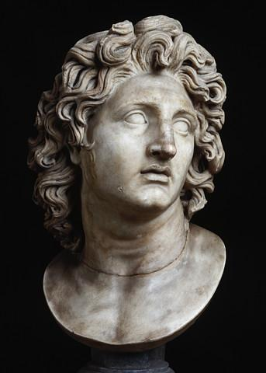
Alexander the Great
What’s so ‘great’ about him?

Slide 2
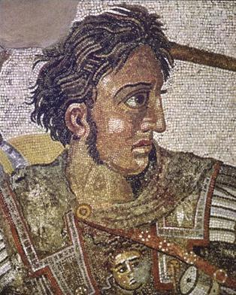
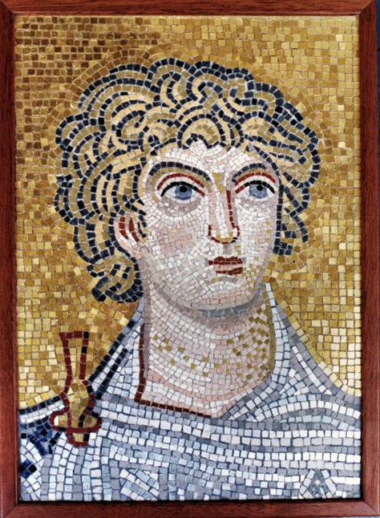

Slide 3
Macedonia
Small, mountainous country north of Greece
Macedonian kings admired Greek culture
natural resources: gold and silver mines

Slide 4
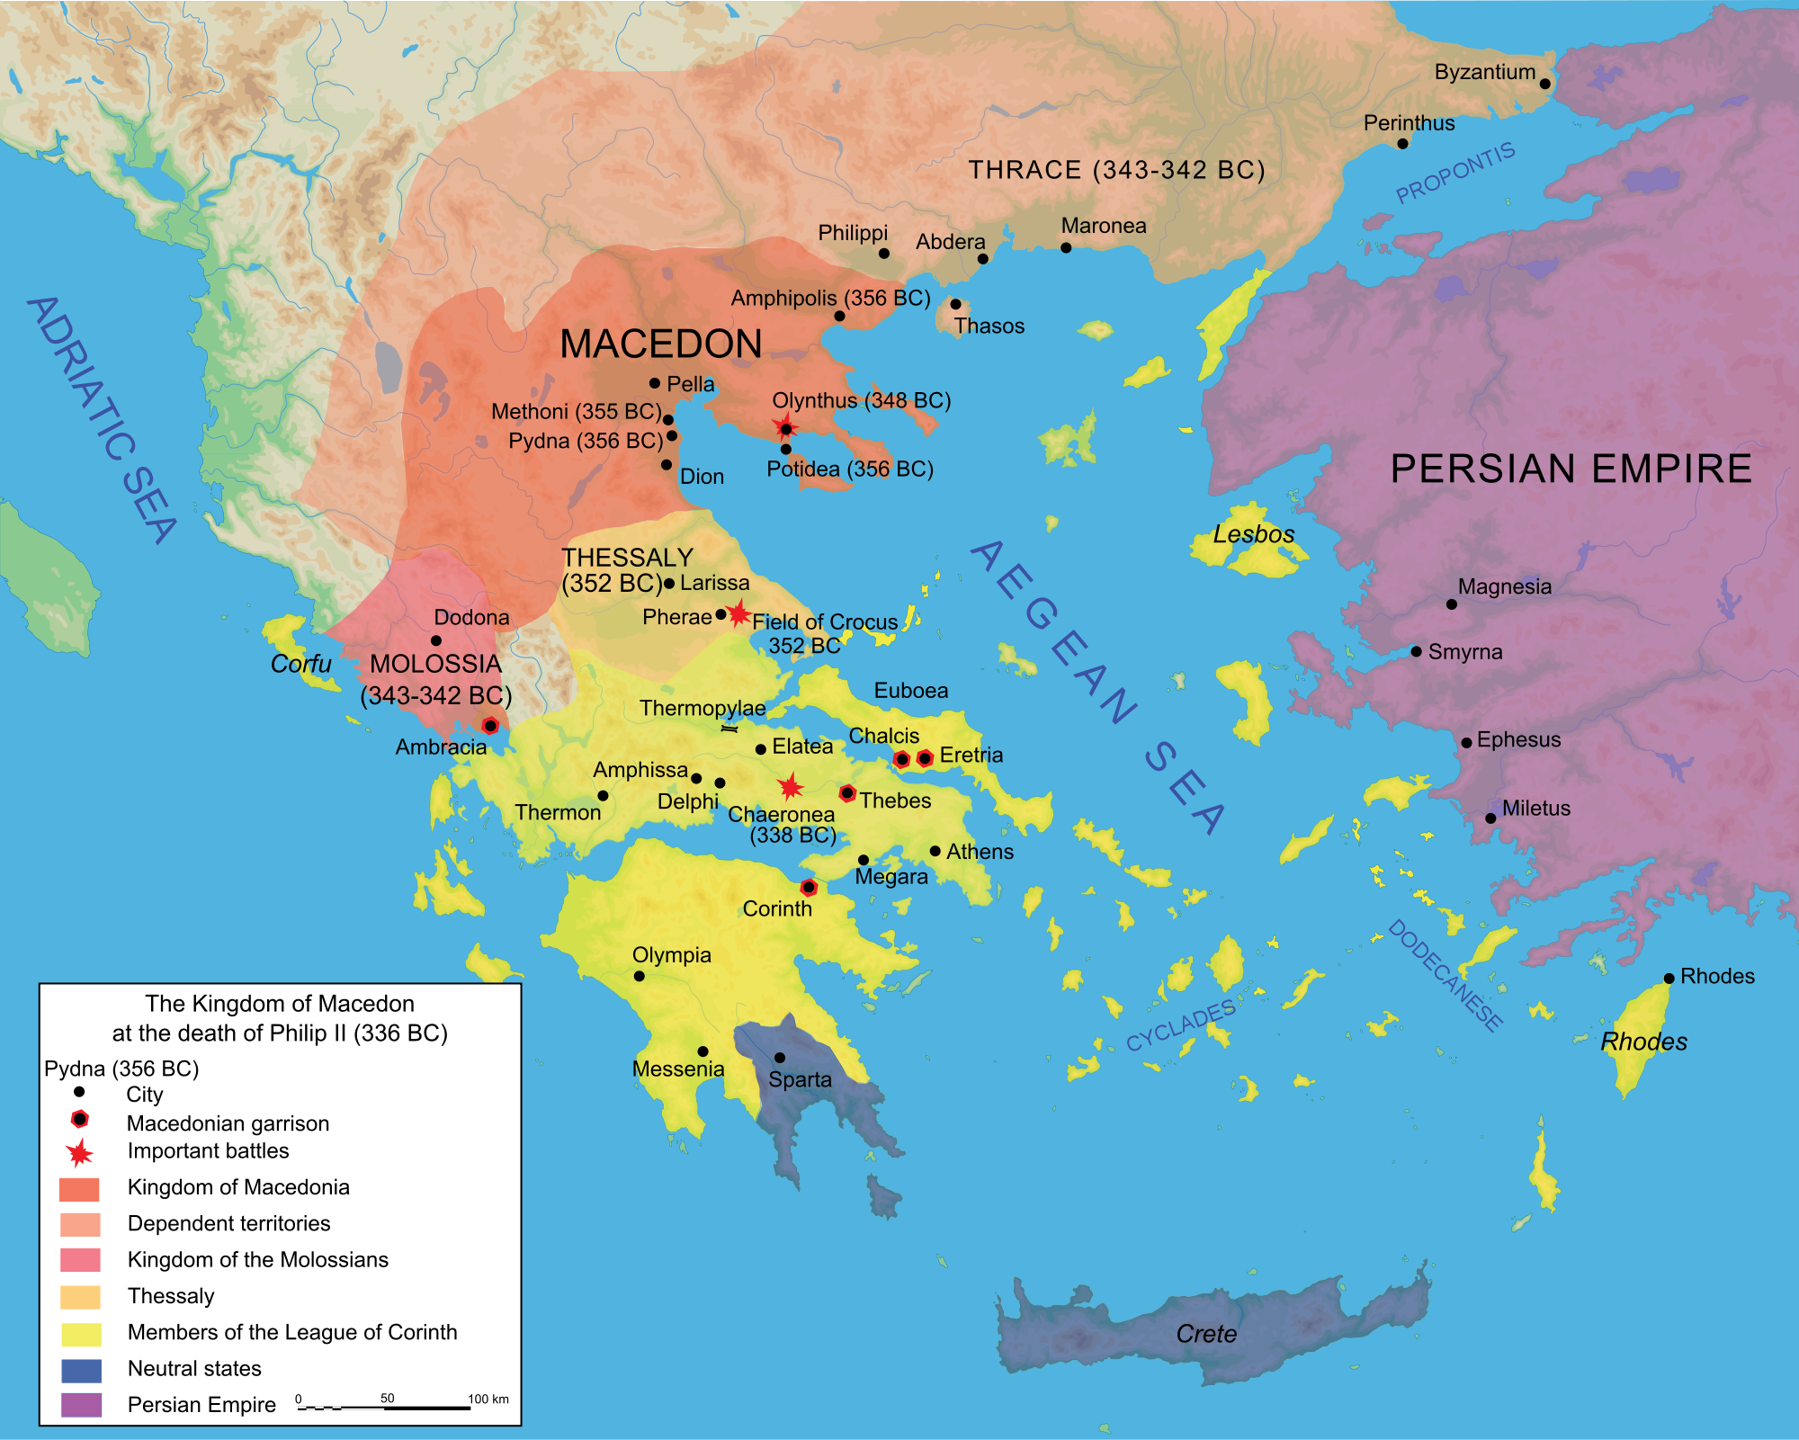

Slide 5
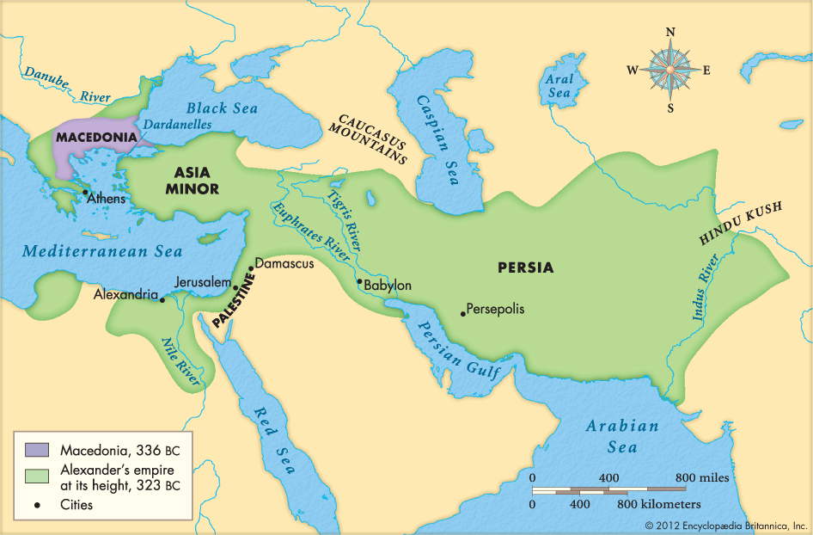

Slide 6
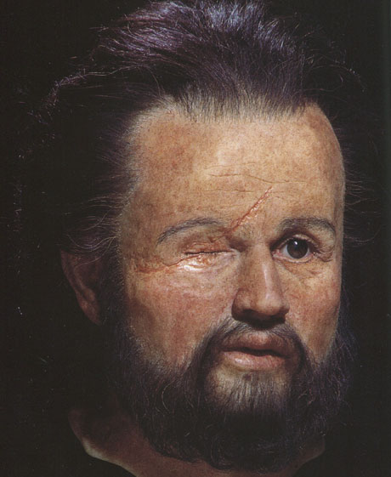
Philip II
Macedonian king, father of Alexander
unifies Macedonia
creates professional army
gains control of Greece

Slide 7
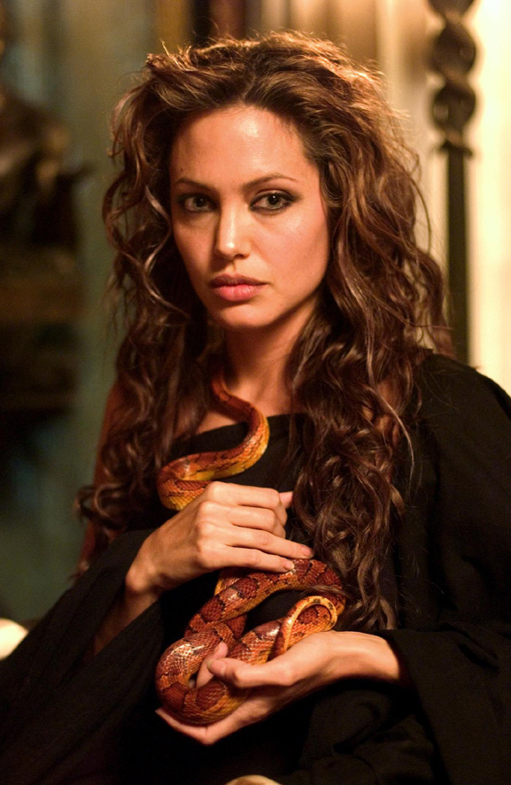
Olympias
possibly a witch
liked snakes
believed Alexander was the son of Zeus (or Dionysus)
Involved in Philip’s assassination?

Slide 8
Philip’s military improvements
soldiers more spread out in phalanx
used large (18 foot long) pikes
used soldiers on horseback (cavalry)
once the phalanx broke through, cavalry charged in

Slide 9
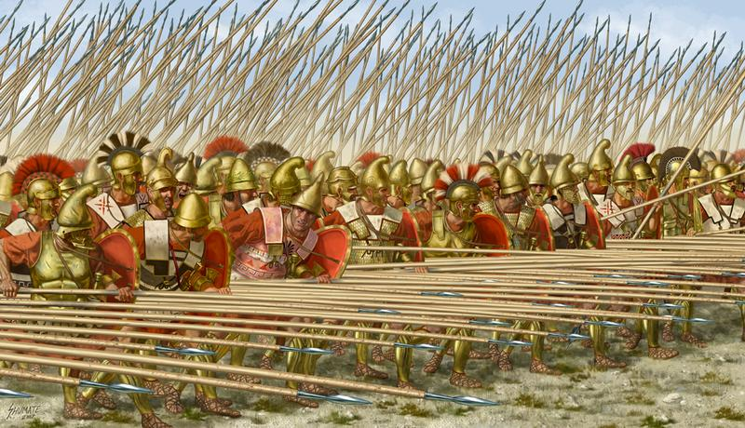
Macedonian phalanx with sarissas (long spears)

Slide 10
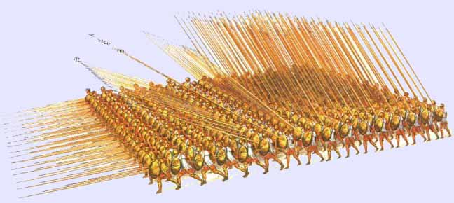

Slide 11
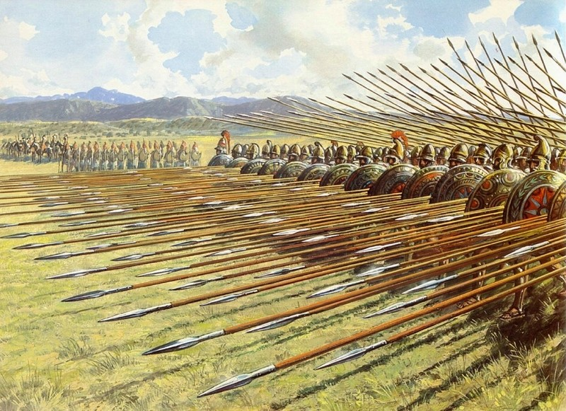

Slide 12
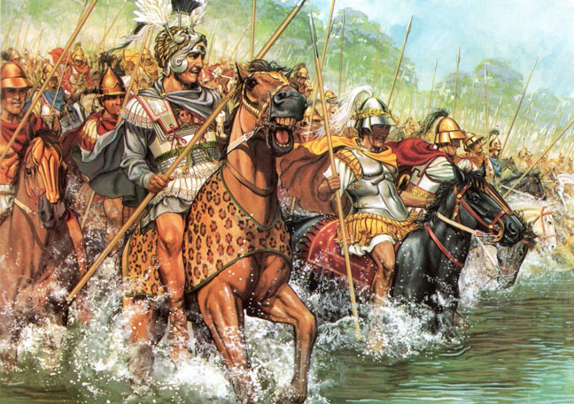
Macedonian cavalry

Slide 13
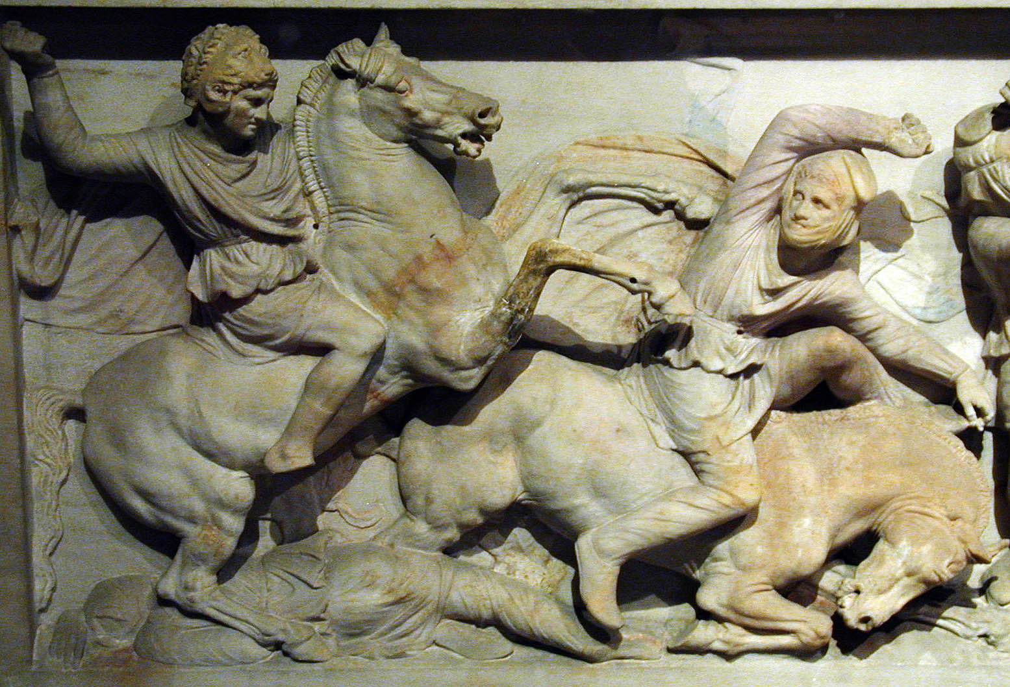

Slide 14
Differences in Phalanxes
Greek
8 men deep
Large shields
All wear heavy armor
Short spear- 6-8 ft
Spear held over arm with 1 hand
Sometimes supported by cavalry
Macedonian
16 men deep
Smaller shields
Few wear heavy armor
(front and back of phalanx only)
Sarissa (pike)- 14-20 ft
Spear held under arm with 2 hands
Always supported by cavalry

Slide 15
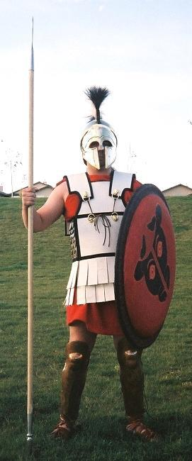
Greek hoplite vs
Macedonian soldier

Slide 16
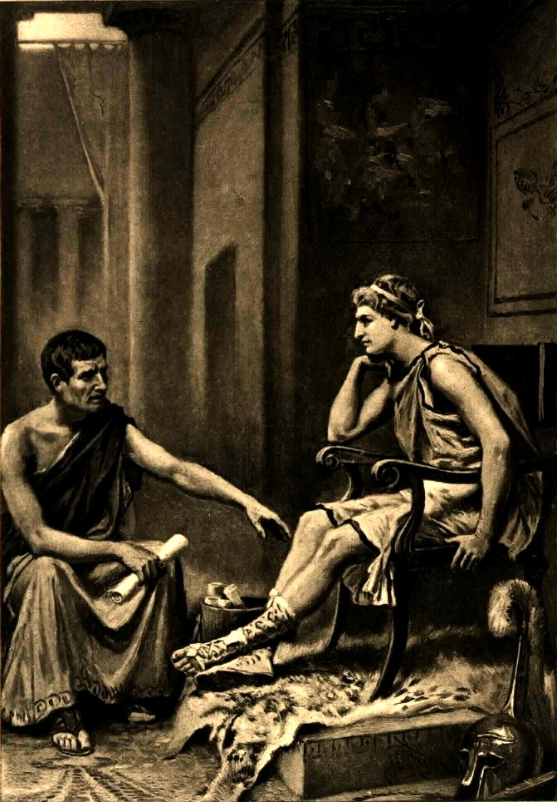
Alexander’s youth
Tutored by Aristotle (literature, political science, geography, biology)
Slept with a copy of Homer’s The Iliad under his pillow

Slide 17
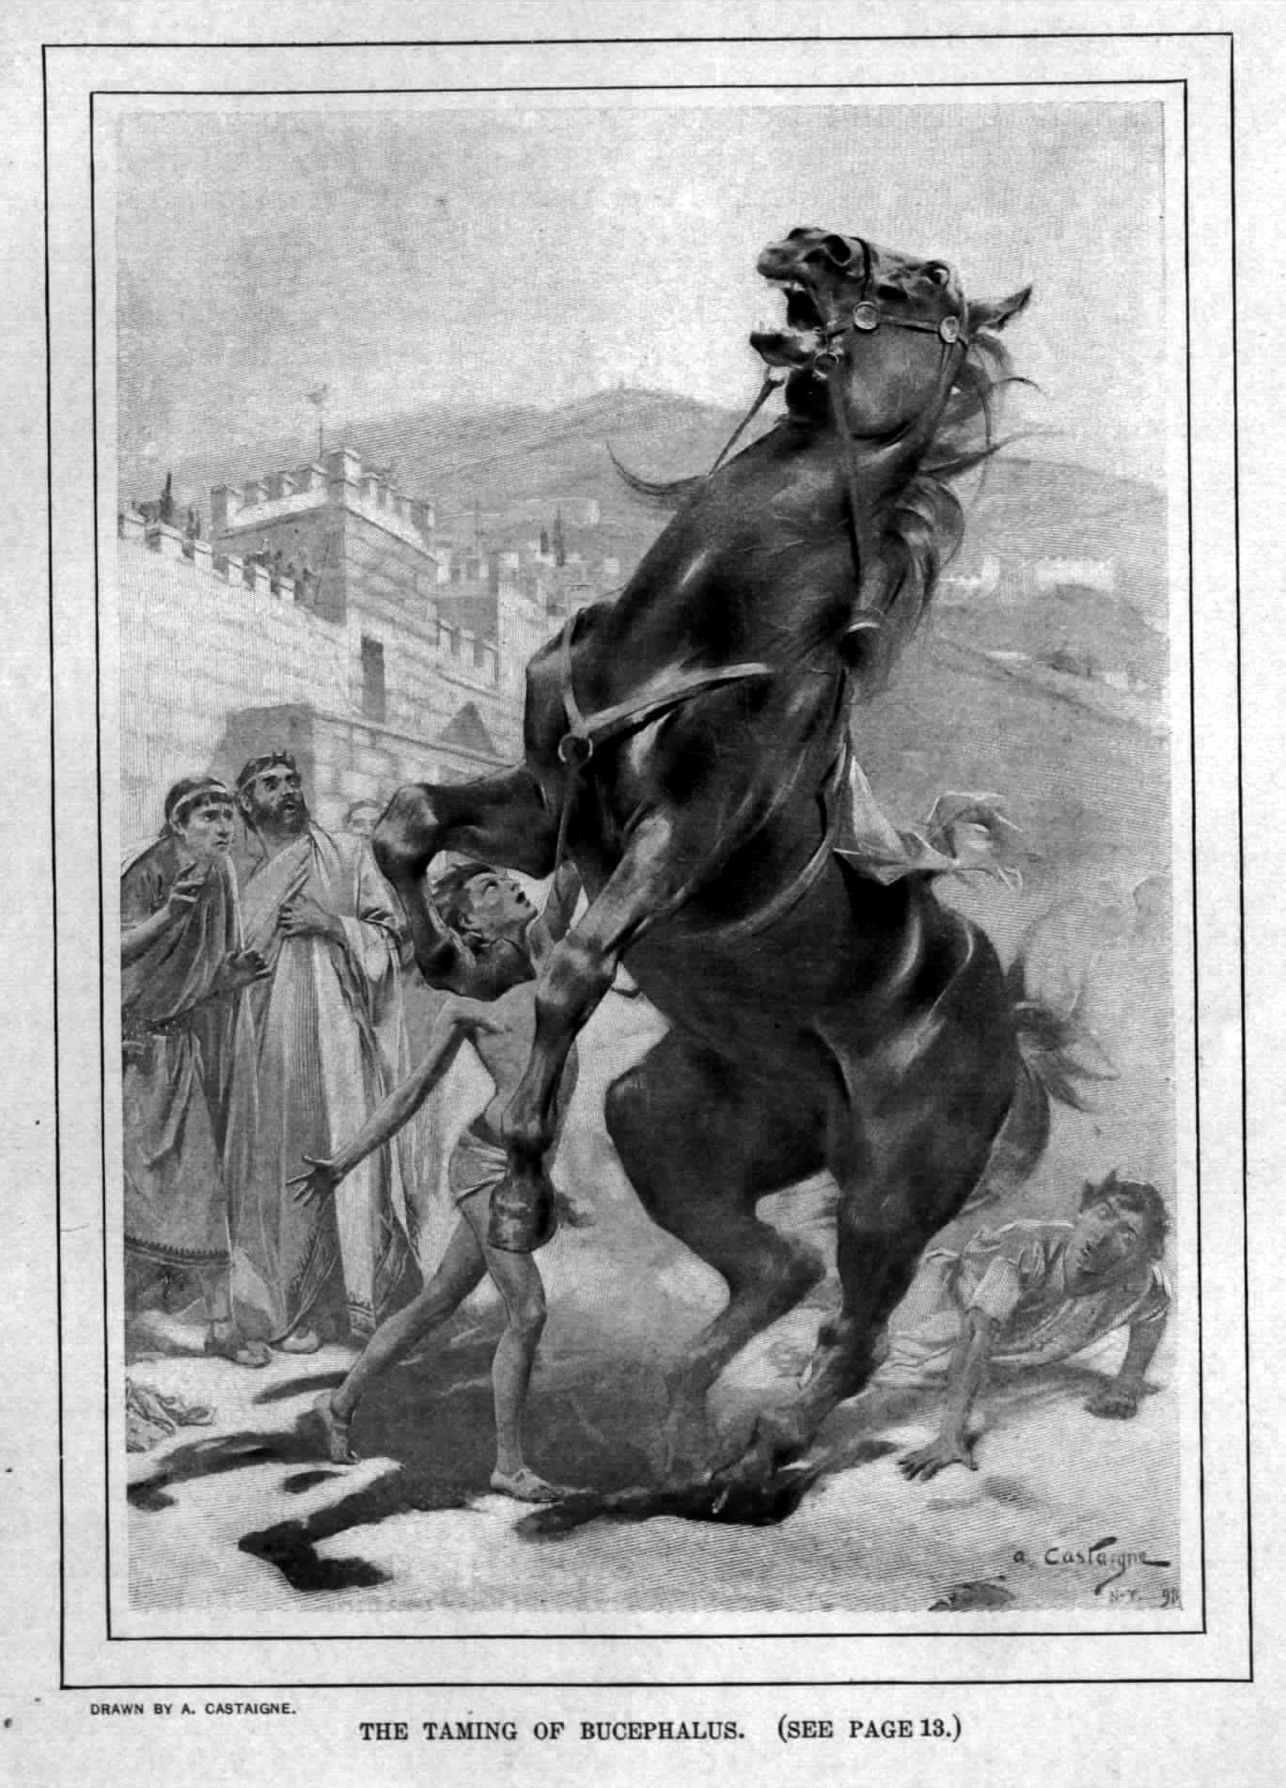
Bucephalus
As a boy, Alexander tamed a horse that nobody else could control
He noticed the horse, Bucephalus, was afraid of its shadow
Bucephalus became a lifelong companion

Slide 18
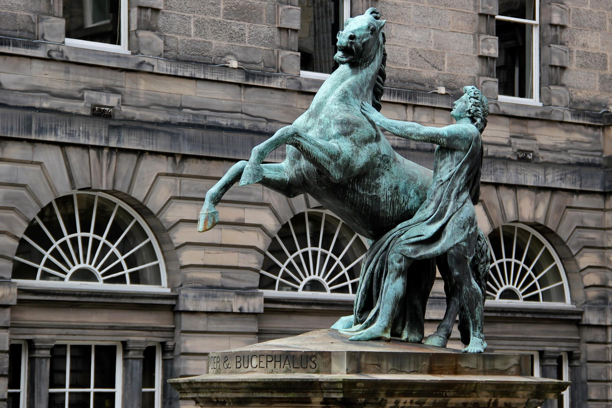

Slide 19
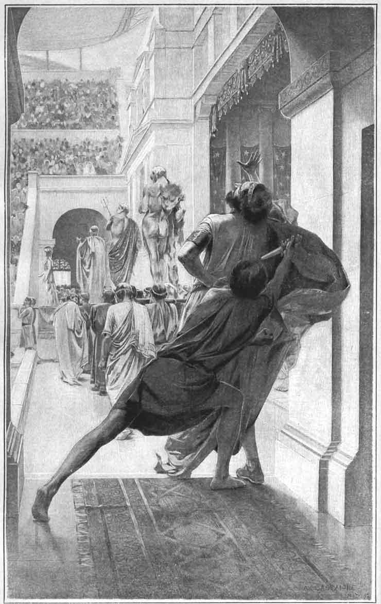
Philip’s Death
Philip is murdered at the marriage of his daughter.
Alexander needs to ensure that he will be selected as the next king

Slide 20
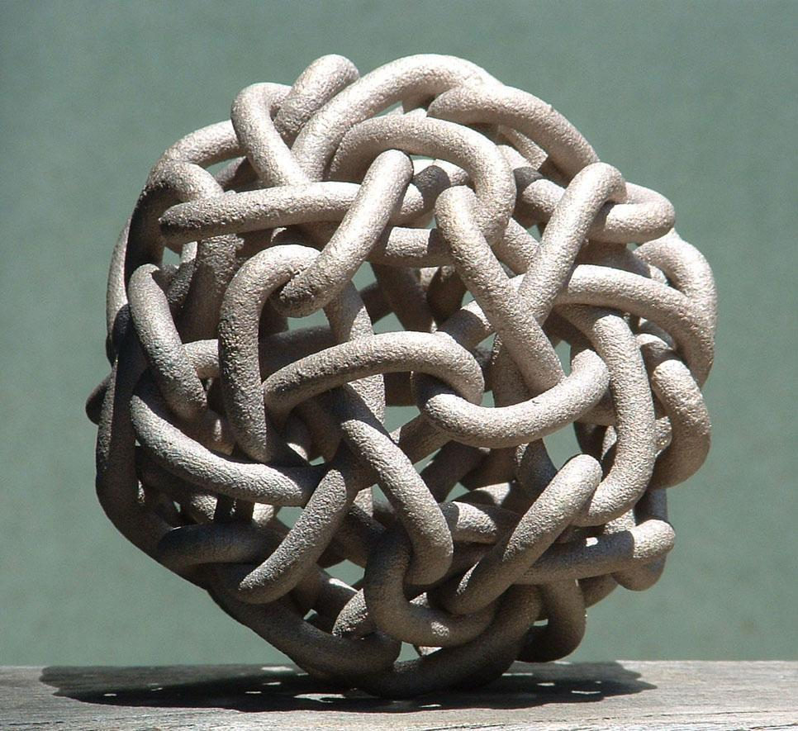
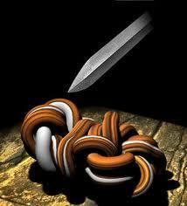
Gordian Knot
Needed to prove his ability to rule by defeating the Gordian Knot.

Slide 21
Speed
Alexander’s army was able to cover vast distances very quickly. How?
First, they lived off the land, but this could be a problem
Second, each soldier carried their own gear on the march
Result- no need for the slow moving wagon trains full of supplies and gear
Result- Alexander was able to catch a number of enemies off guard and unprepared for battle

Slide 22
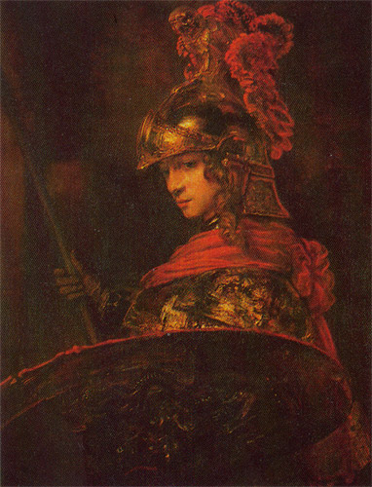
Alexander as general
Fearless
Never lost a battle
conquered Persia and Egypt
empire stretched from Nile to Indus

Slide 23
Alexander’s ambition
After defeating Persia, Alexander wants to continue on conquering.
What problems might this cause with the army?

Slide 24
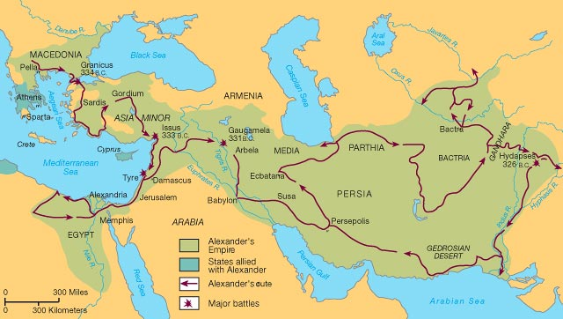

Slide 25
Alexander’s death
Died in 323 BCE, at 33 years old
body wrapped in gold and placed in a glass coffin
Sent to Alexandria and became a shrine

Slide 26
What if?
If Alexander had lived, do you think he would have been as successful in ruling his empire as he was in building it?
Think about
skills needed for military leadership
skills need to govern an empire
Alexander’s demonstrated abilities

Slide 27
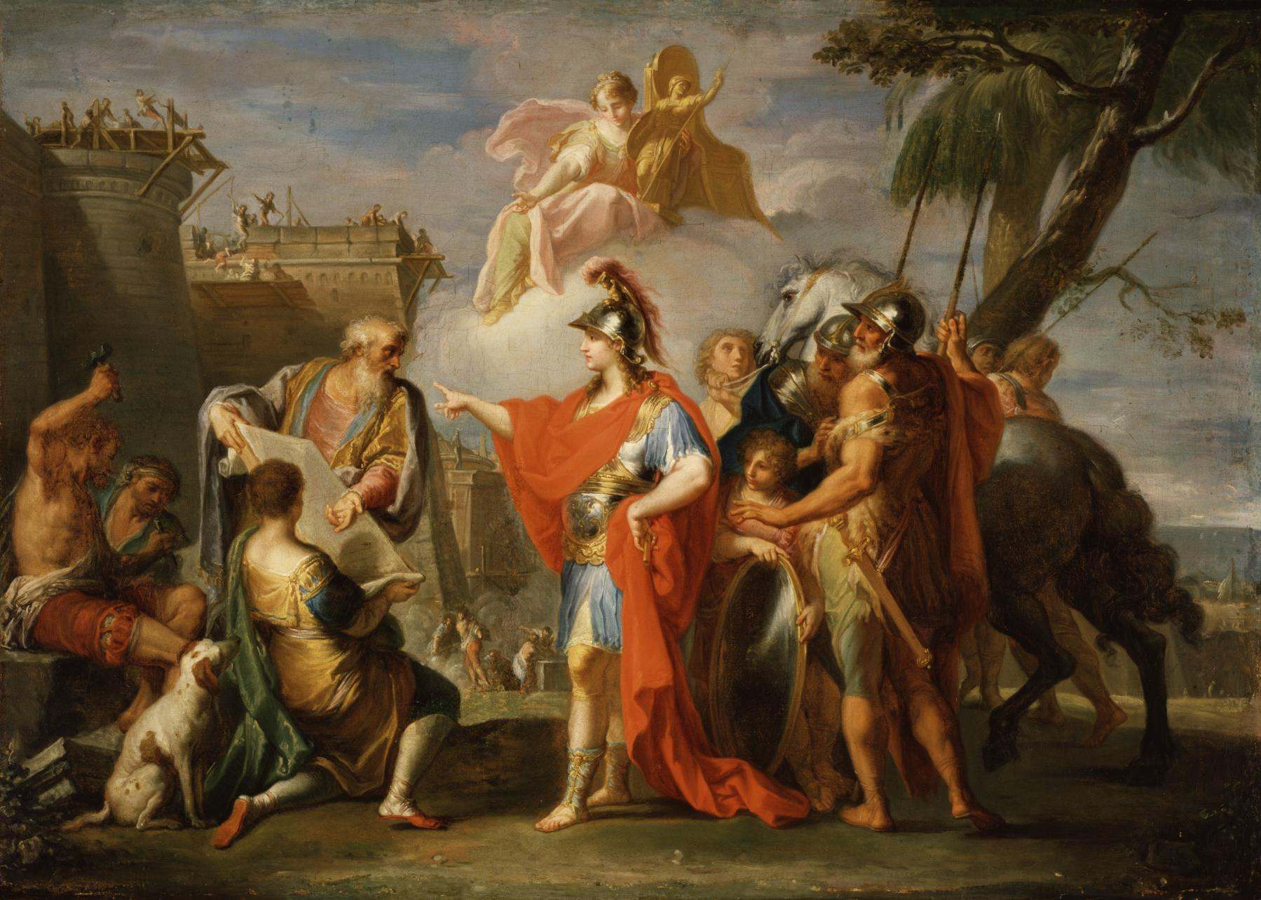
Alexander founding Alexandria, Egypt

Slide 28
The spread of Hellenistic culture to the east
Greek language becomes common
Greek architecture is copied
Created new cities with Greek style architecture
Greek philosophy and studies spread
Greek plays were popular form of entertainment
“Hellenistic Age”
Hellenistic = like the Hellenes, or Greeks

